Slide 1
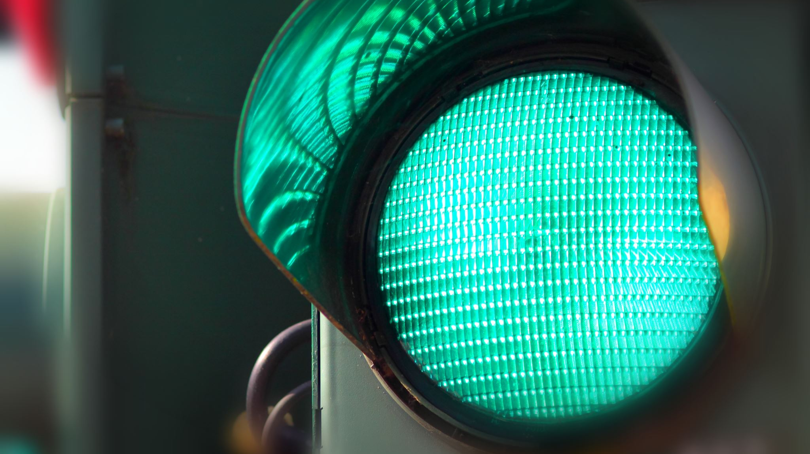
Traffic monitoring using Doppler radar
Mishay Naidoo

Slide 2
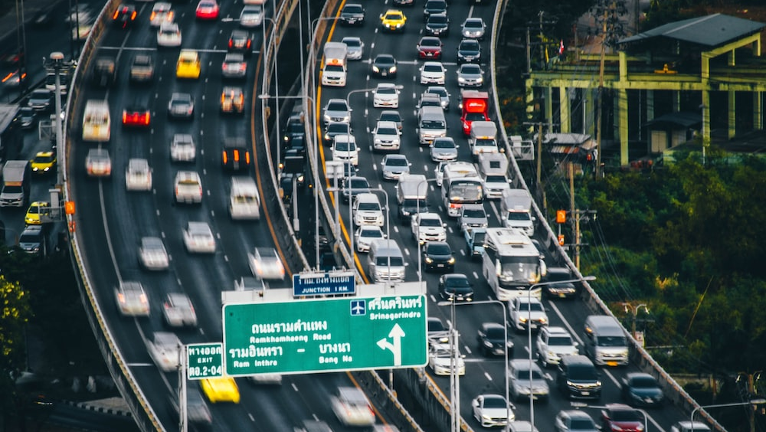
Problem
Local governments require traffic intensity data for future road planning, maintenance and pollution monitoring. However, there are currently few affordable and accurate tools for obtaining this data reliably.

Slide 3
Why radar?
Video Camera’s may not work during bad weather or at night and infringe on people’s privacy.

Slide 4
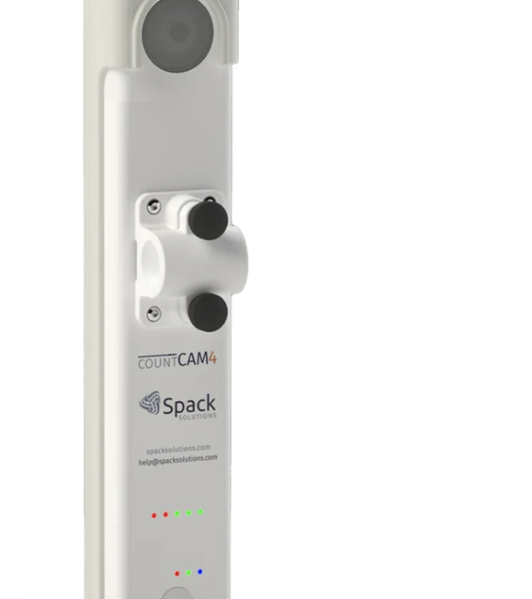
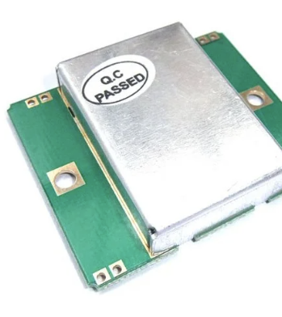
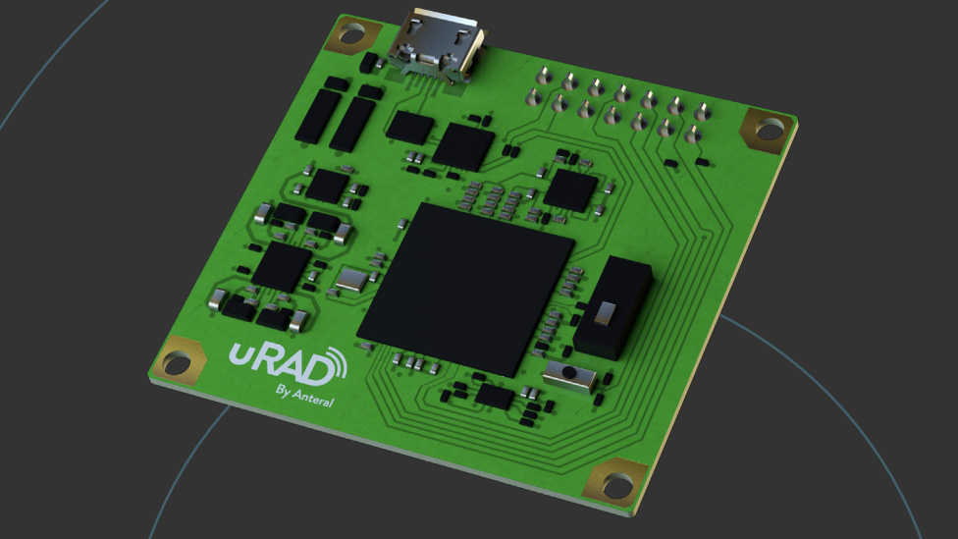
Existing solutions
CountCAM uses a camera and costs $1699.
uRAD uses FMCW radar for traffic monitoring but costs €250.
Radar Amit linked for me to try use costs R50.

Slide 5
Timeline
Learn Radar
Spent last week learning basic concepts
Literature Review
Spend this week completing Lit Review
Hardware
Research and order hardware options. Work on report and software while waiting for hardware.
Obtain Data
Use Hardware to obtain testing data. Obtain data on campus most probably.
Software
Extract important information from data.
Report
Compile and submit report.

Slide 6
Scope and limitations
Scope
limitations
Use a cheap doppler radar to monitor traffic. $100 or less.
Identify a 2x2 grid of cars.
If possible, identify the type of car e.g Sedan or Truck.
Time
My limited knowledge of radar ☹

Slide 7

THANK YOU

